Slide 1

Comprehensive Digital marketing project work on Axis Bank
AXIS BANK

Slide 2
Details of the project:-
-Topic of the project:Axis Bank
-Research and brand identity:
Brand logo:AXIS BANK
Brand colour:White and red
Brand tagline:Badhti Ka Naam Zindagi
Brand website:https://www.axisbank.com
CEO of Axis Bank: AMIABH CHOWDHURY

Slide 3
Team Details
Koduru Bhavani(Team leader)
Guntuku Dhilleswari (Team member)
Jampina Mani(Team member)
Kanta Dilleswari (Team member)
Kommuru Vijayalaxmi(Team member)

Slide 4
PART 01
Brand study, competitor analysis & buyer's/audience's persona

Slide 5
Brand study:Axis Bank is the 3rd largest private sector bank in india.To evolute the risk Exposure of bank in last 5 years and predict the future performance of the bank.
Mission values:Customer centricity,Ethics,transparency,team work and ownership.These defines the matter in which we deal with various stakeholders and outlined.
e text addition

Slide 6
USP(selling preposition): Decided to provide a huge range of financial products and service to meet the diverse need of its customers.
Brand tone and identity:A brand is your bank's identity -it's personality,values,traits.It is a tangible and intangible asset that provide shareholder values and longivity.Yes distinguishes yours business from others.

Slide 7
5 Smart goals and KPI:Customer integrated offering for all entities.
•Seamless digital on-bording with unified KYC.
•Instant funding with enhancement LinkedIn to business growth
•Fostering synergies between ecosystem entities enabling credit access and flexible payment terms•
KPI-KPI in banking operation can be defined as quantities Values used to determine how efficiently and effectively specific banking operations goals and objectives achieved by a bank over a certain period of time.

Slide 8
Competitor analysis:After researching direct and indirect digital banking cometitor,it's time to discover their offering fully Analyze your strength , weakness,opportunity,Threats.
Competitor 1-HDFC:It is a limited in an Indian Banking and financial Service.HQ is at Mumbai 4th largest Bank by marketing capitalisation.
Competitor 2-Bandhan:It is present in 35 out of 36 union territories in India ,6140 banking outlets and 3,01 crore customer.HQ is at Kolkata .
Competitor 3-Idusland Bank:It was inaugurated in April 1994 by then union finance minister Manmohan Singh.HQ ia at Mumbai.

Slide 9
PART -.2
SEO & keyword Research

Slide 10
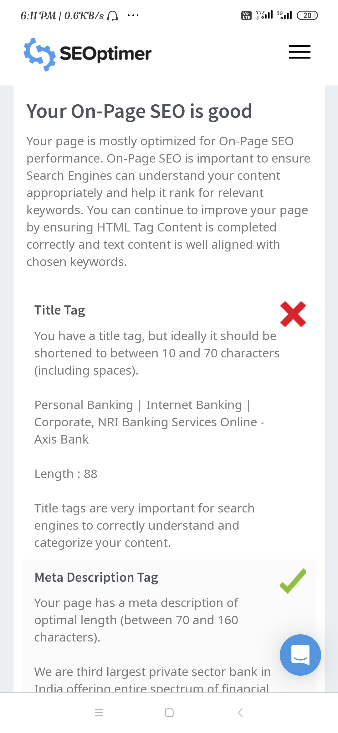
SEO Audit :
PART 02
PART 02

Slide 11
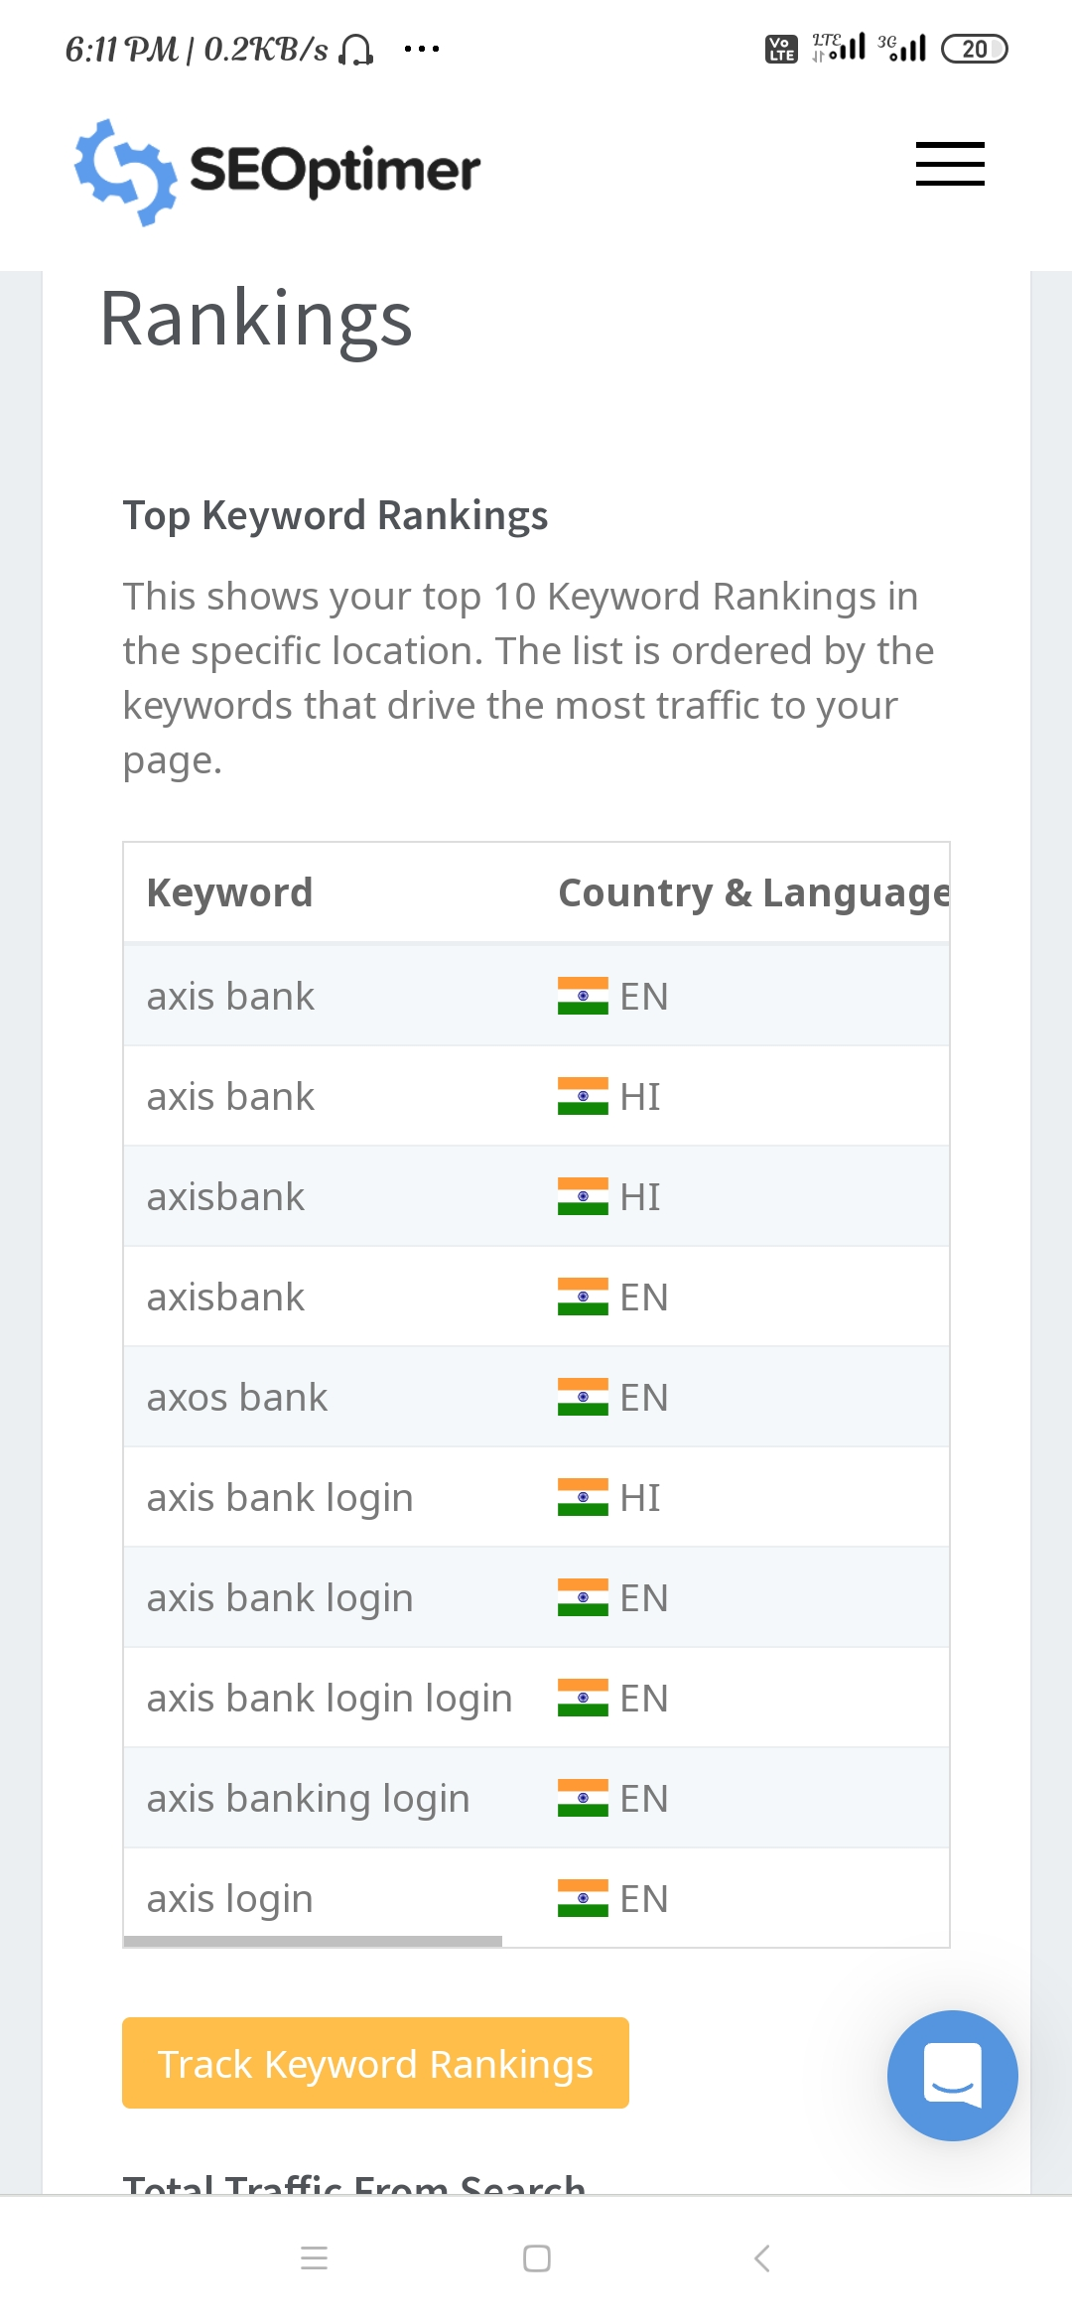

Slide 12
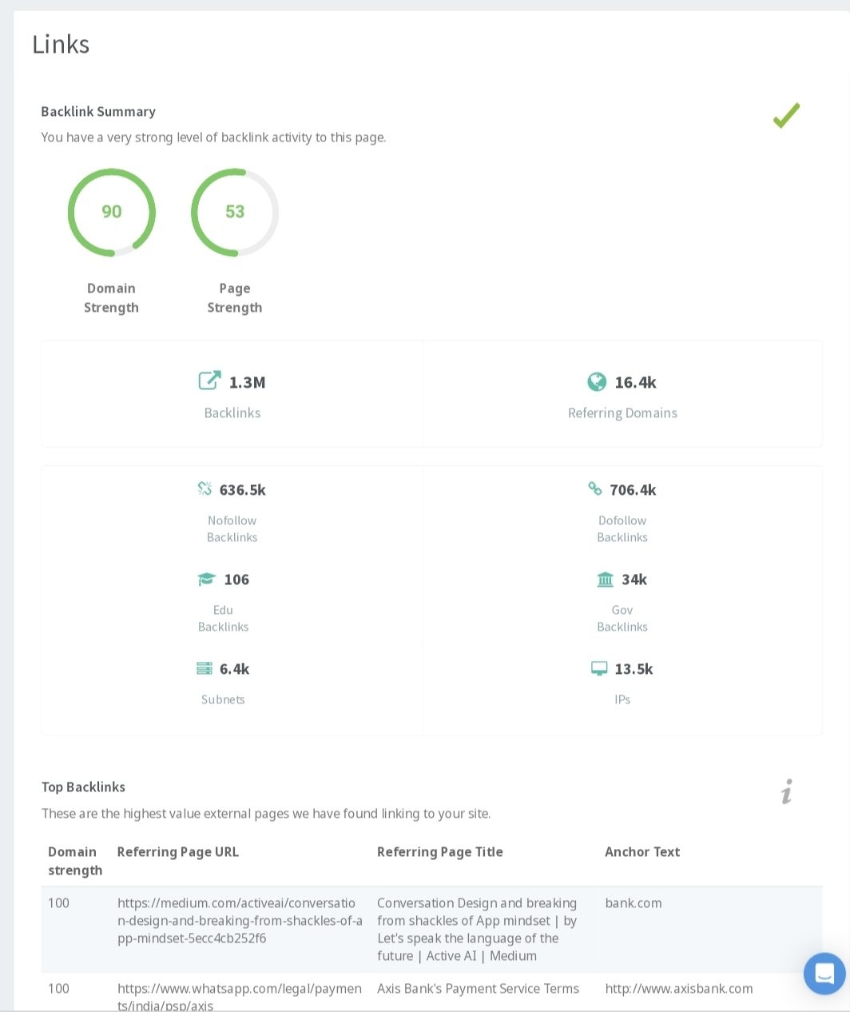

Slide 13
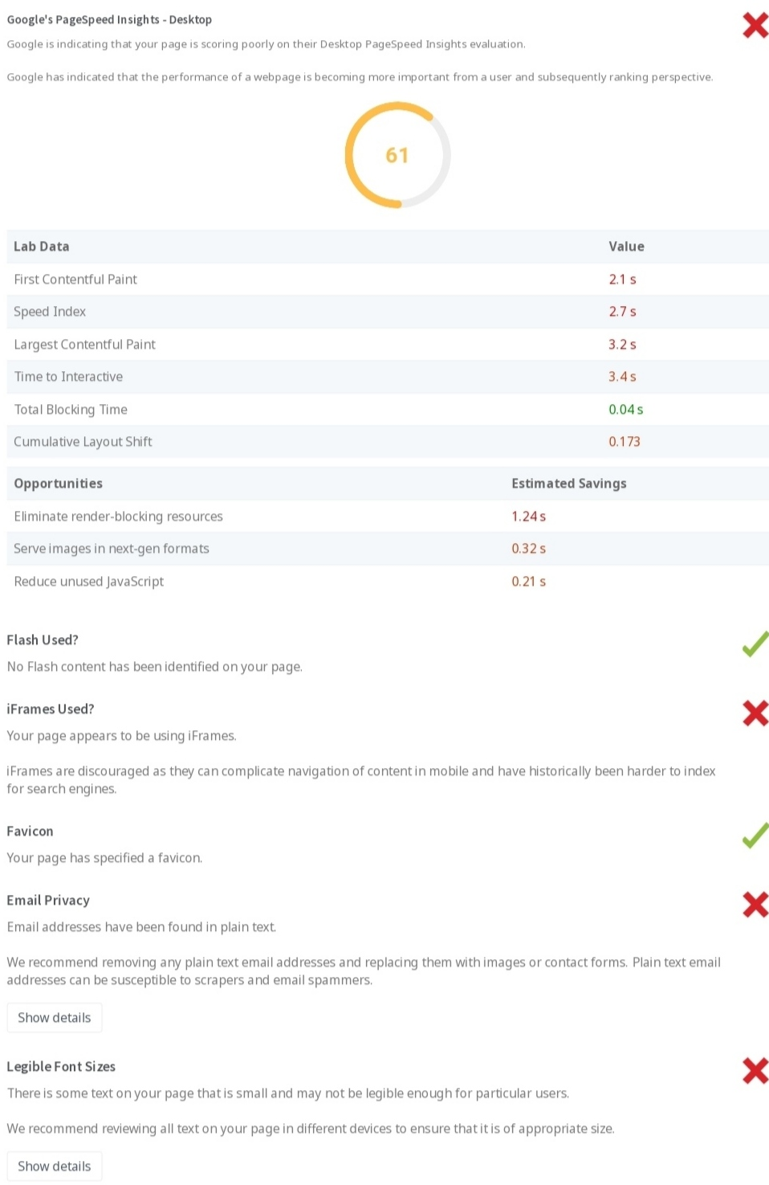

Slide 14
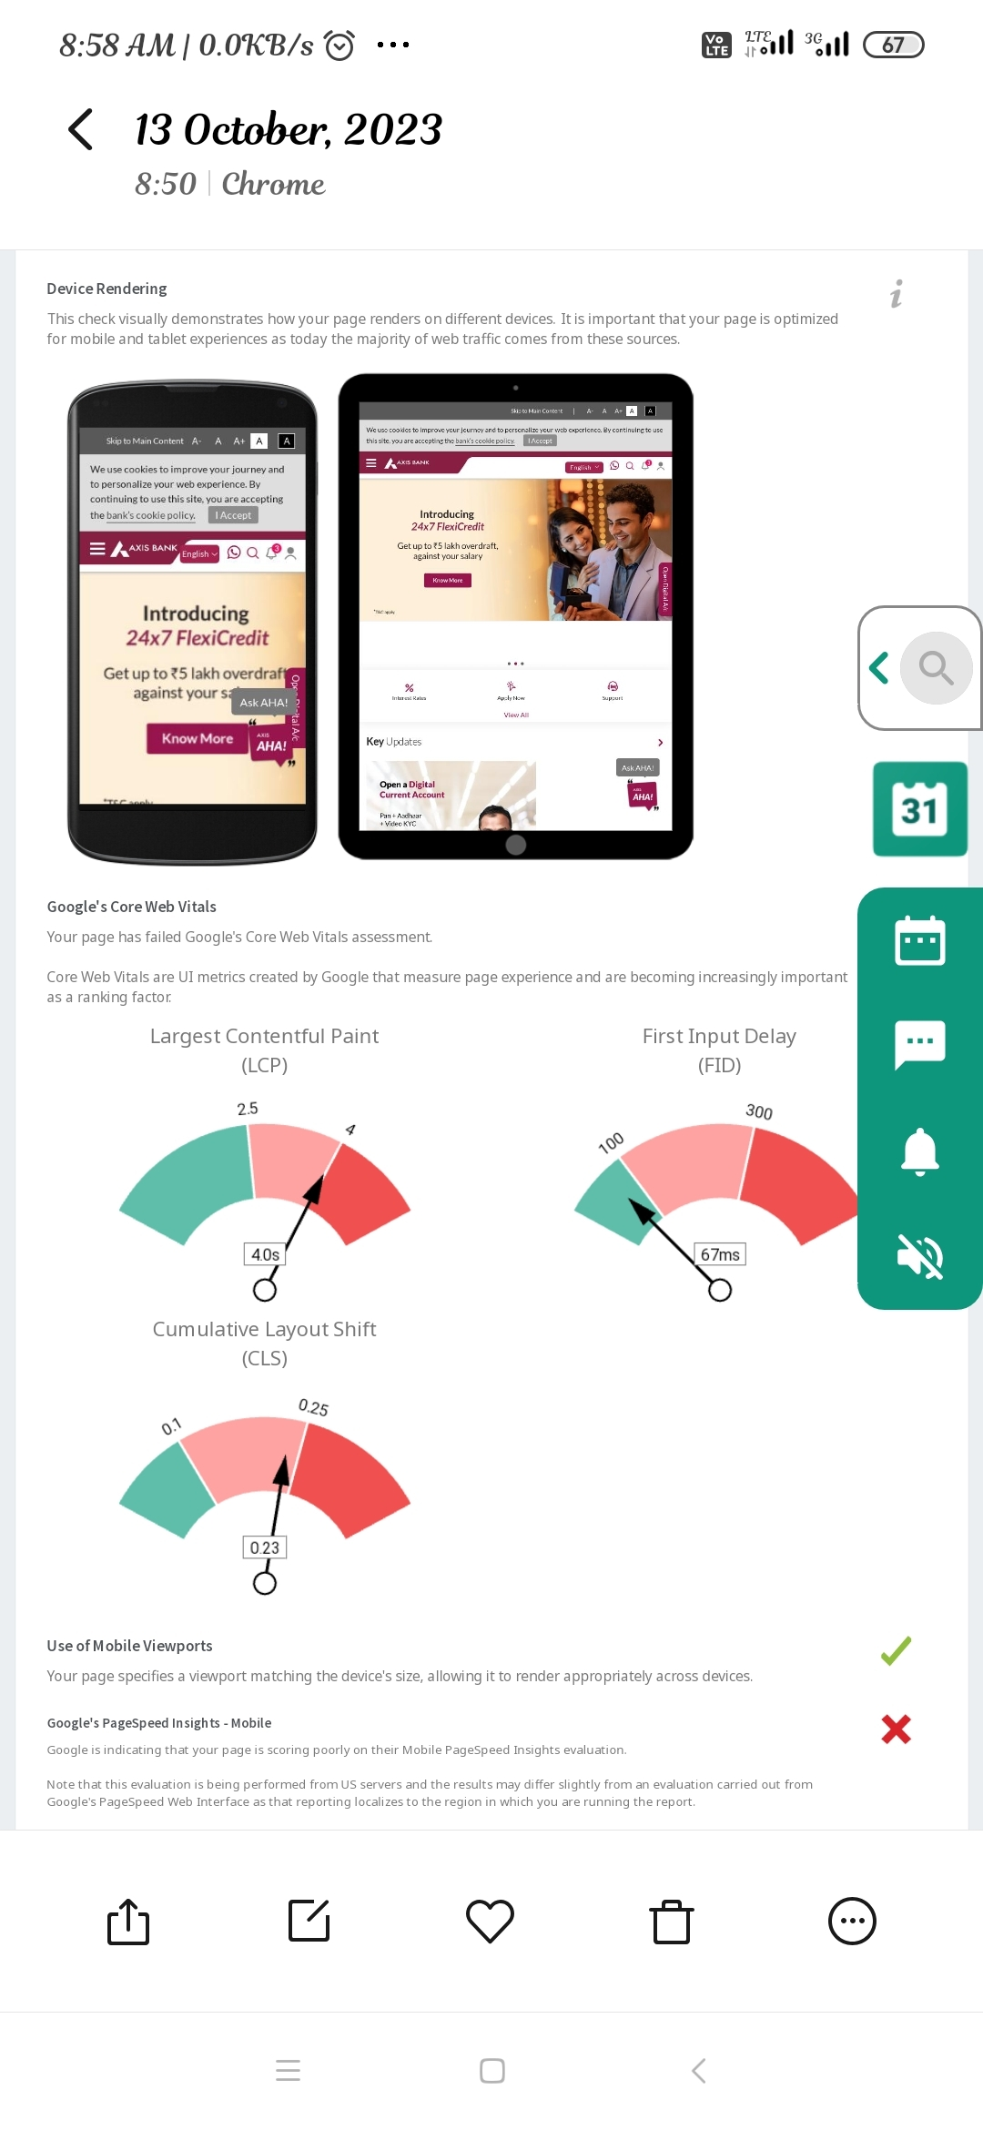

Slide 15
Keyword research objectives:
Keyword research is the practice of researching common industry specific terms and phrases that are driving such traffic to search engine result pages.This is the time -tested first step in search engine optimization (SEO) for any website.

Slide 16
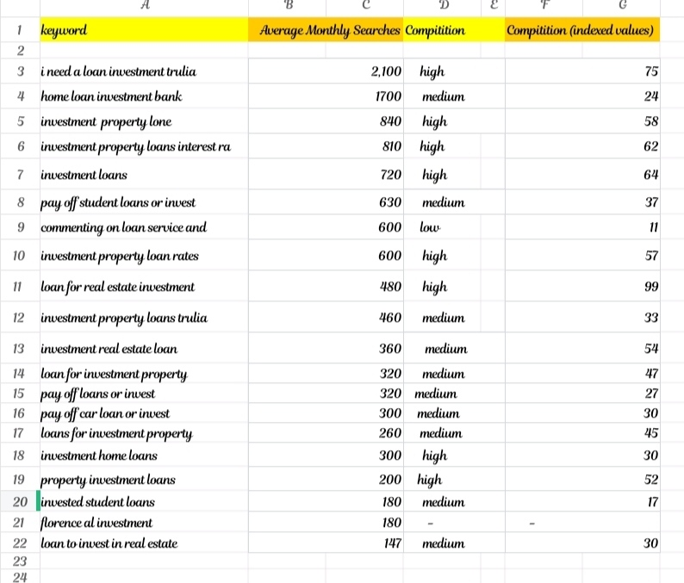
Brainstorm seed keyword:

Slide 17
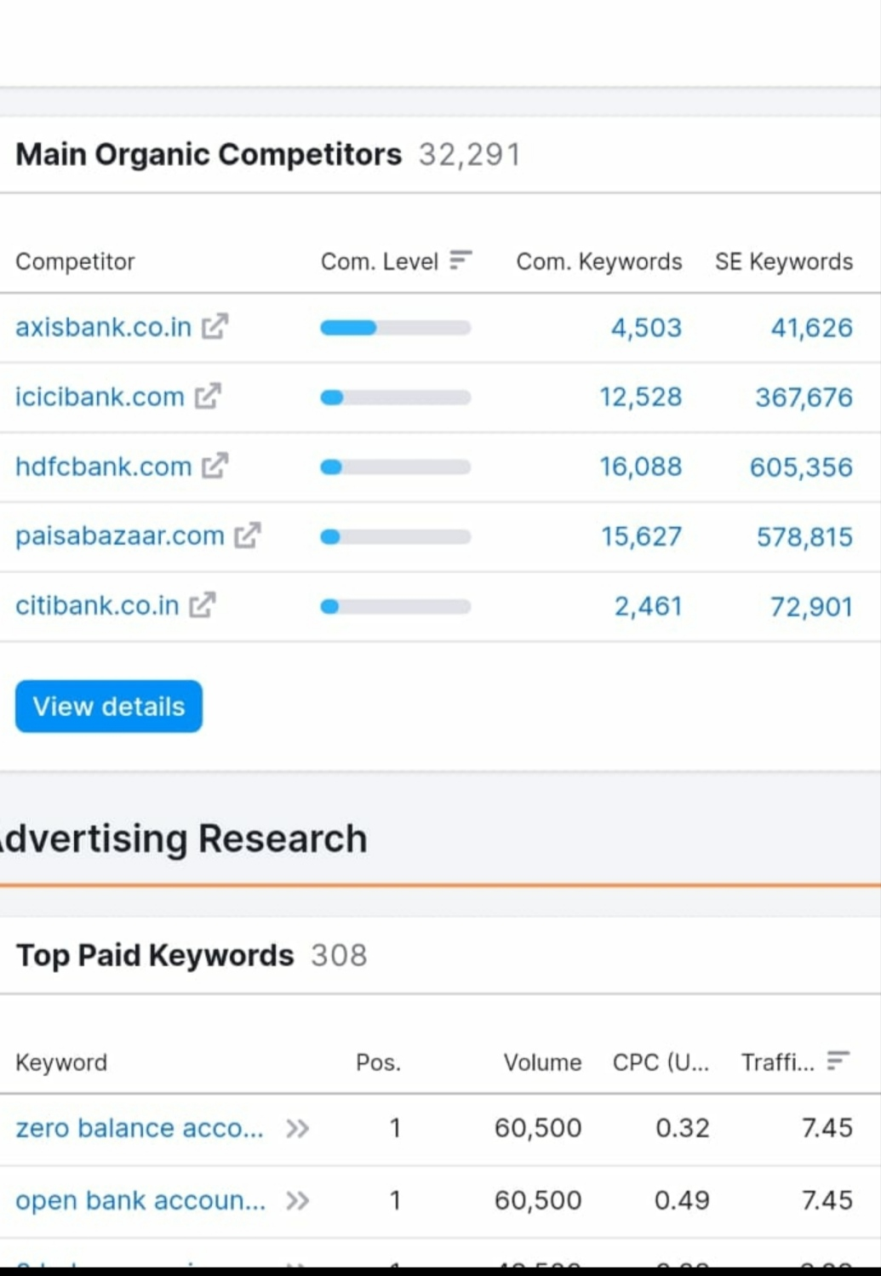
Competitor keyword:

Slide 18
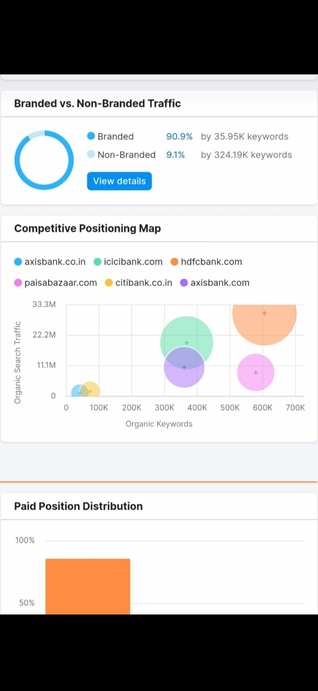
02
03

Slide 19
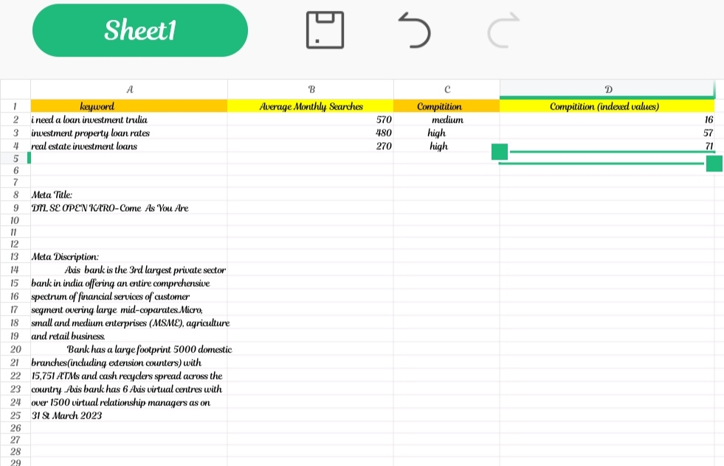
On page optimisation:

Slide 20
PART-3
Content ideas and marketing strategies

Slide 21
Content ideas generation and strategies:
We are committed to creating an open and Inclusive environment ,one where people share ideas
learn from eachother,helping knowledge to spread throughout the organisation.

Slide 22
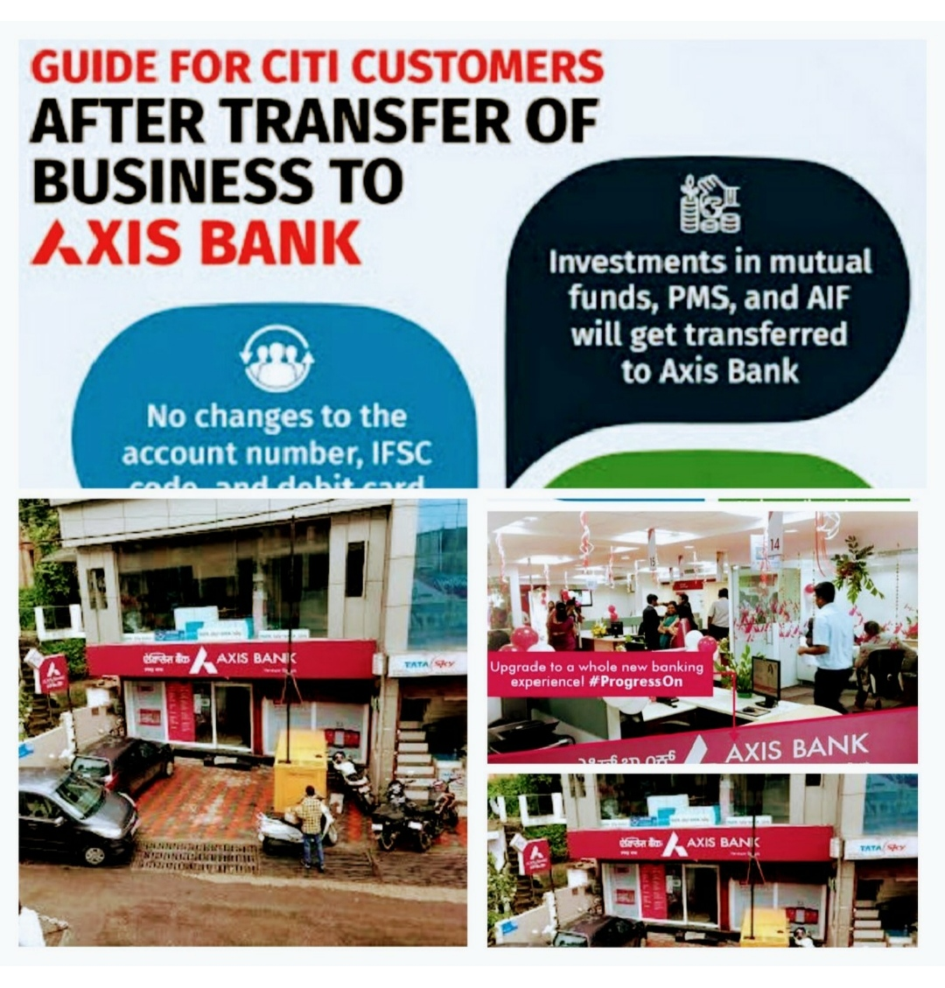
Visit Here

Slide 23
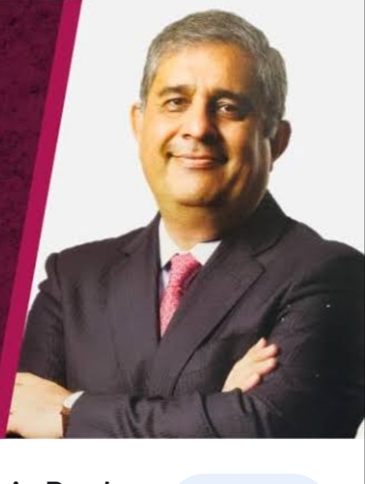
Amitabh Chowdary
"Every thing is created twice, first in mind and next in reality .Think like leaders,dream big and create an even bigger reality ".......Know more

Slide 24
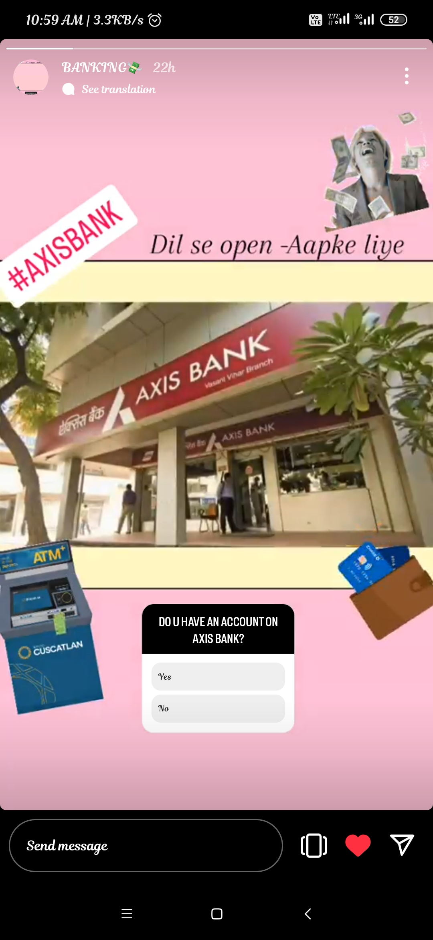
INSTAGRAM STORY:
https://www.instagram.com/s/aGlnaGxpZ2h0OjE4MjQwODgyNzg3MTc0NjEz?story_media_id=3212532546653697458_62444426003&igshid=NDA3YzJlZDM2MQ==

Slide 25
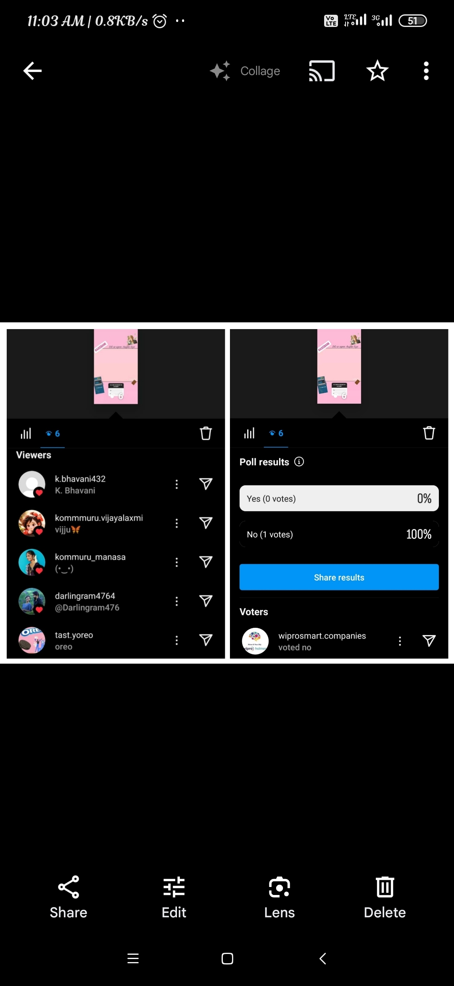
History of a Instagram story:-

Slide 26
PART -4
VIDEO EDITING

Slide 27

Thank you for Watching

